Slide 1
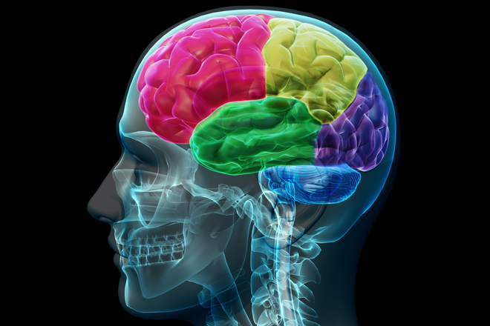
Reducing the Risk of a Recurrent Stoke
Skyler Sherrell, BSN, RN, Graduate Student, PCNP Program
Bonnie Sanderson, Faculty Advisor
Target Population and PICO Question
Introduction, Background and Signifigance
Results, Conclusion and Summary
Target Population: Adult individuals over the age of 18 years old who have suffered from a stroke or TIA.
PICO Question: In adult patients who have been diagnosed with a CVA or TIA, what methods, including medications and lifestyle changes, can be used to decreased the risk of recurrent CVA or TIA?
P: Adult patients who have been diagnosed with a CVA or TIA
I: Medications and lifestyle changes
C: Making these changes or not
O: A decrease recurrent CVAs or TIAs
T: Does not apply
Introduction: With a continued rise in the number of strokes across the United States each year, it is more important than ever to ensure that nurses caring for these patients are adequately informed related to the newest evidence.
Background: The purpose of this small test of change was to determine if the knowledge base of staff nurses in a neuroscience unit was increased after an in-service related to the latest evidence is provided. Because of the increase in knowledge base, the results were analyzed to determine trends or patterns.
Significance: Nearly 25% of strokes that occur yearly in the United States are preceded by a CVA or TIA , making it even more important to provide education related to reducing these risks.
Results
Group 1 (Pre-test Group)
Median Score: 9.00
Mode: 9
Standard Deviation: 1.885
Median Age: 29.5
Median years of Experience: 5.00
Group 2: (Post-test Group)
Median: 9.50
Mode: 10
Standard Deviation: 0.816
Median Age: 27.00
Median years of Experience: 4.00
Conclusion
The significance of the intervention is 0.023 when calculated via t-test.
Summary
Though there were 8 participants in group one and six in group 2, the intervention proved to significant in increasing the knowledge base on neuroscience nurses that were tested.
Literature search, Summary of Evidence and Recommendations
Literature Search:
Auburn Database (CINAHL, MEDLINE (EBSCO, PubMed)
American Heart Association
Phrases used: “Recurent stroke,” “prevention,” “medications,” and “lifestyle changes.”
Summary of Evidence:
The risk of recurrence 1 year after initial attack is 8.0%
The risk of recurrence is 30%-40% within the first 5 years after original infarct
45%-65% of strokes occur within 30 days of a TIA
Risk of death within 1 year after stroke is 24.5%
Recommendations:
A target blood pressure should be based on each individual patient, but normal levels should be less than or equal to 120/80. (Grade: B)
Patients who smoke should be advised to quit smoking and to avoid environmental tobacco smoke. (Grade: C)
The healthcare provider can aid in smoking cessation by offering different methods of tobacco replacement. (Level B)
Those who are able to engage in physical activity should engage in at least 30 minutes per day. (Grade: C)
An anticoagulant or antiplatelet should be prescribed to each patient suffering from an ischemic stroke at discharge. (Grade: A)
Small Test of Change
Small test of change: Determining the effectiveness of an in-service on staff nurses of a neuroscience unit to increase education related to post stroke care.
Implementation: Nurses at Baptist Medical Center neuroscience unit were given a verbal in-service, along with pamphlets with education related directly to reducing the risk of a recurrent stroke post discharge.
Evaluation: Nurses were given a pre-test and post-test that were comprised of the same 10 questions. Data was anonymously collected related to the age, gender, and years of experience of the nurse, along with the total score of the pre and post tests.
References
Bergman, D. (2011). Preventing recurrent cerebrovascular events in patients with stroke or transient ischemic attack: The current data. Journal Of The American Academy Of Nurse Practitioners, 23(12), 659-666. doi:10.1111/j.1745-7599.2011.00650.x
Lennon, O., Galvin, R., Smith, K., Doody, C., & Blake, C. (2013). Lifestyle interventions for secondary disease prevention in stroke and transient ischaemic attack: a systematic review. European Journal Of Preventive Cardiology.
Goldstein, L., Bushnell, C., Adams, R., Appel, L., Braun, L., Chaturvedi, S., & ... Pearson, T. (2011). Guidelines for the primary prevention of stroke: a guideline for healthcare professionals from the American Heart Association/American Stroke Association. Stroke (00392499), 42(2), 517-584. doi: 10.1161/STR.0b013e3181fcb238

